Slide 1


AI- BASED HEART STROKE PREDICTION USING ECG AND PPG BIO-SIGNALS
GST - Bengaluru Campus
Department of Computer Science and Engineering
Project Phase-I Presentation
Under the guidance of
Enter the Guide Name
and Designation
Presented by
Student Name1 and Roll Number
Student Name2 and Roll Number
Student Name3 and Roll Number
Student Name4 and Roll Number

Slide 2

Outlines
Research Objectives
Abstract
Existing work
Problem Statement
Introduction
Literature Work
Proposed Models
Architecture Diagram
List of Modules
Results
Conclusion
References

Slide 3
RESEARCH OBJECTIVES
1. Develop an AI-based decision Heart stroke prediction system.
2. Utilizing the data of Heart stroke and AI based decision making algorithms for predicting Heart strokes.
3. Implementing deep learning techniques to predict Heart strokes.

Slide 4
ABSTRACT
This work aims to predict the Heart stroke on the basis of the data collected from the different patients using an AI based decision makers. The data will be collected from the database namely physionbanktm or any other publicly available databases of Heart strokes. We will implement Artificial Neural Networks (ANN) as the decision maker in our work. The ANN will be first trained on the different datasets collected from the above mentioned databases, the training phase will be validated following the test phase, in which we will test the ANN for it’s accuracy. We are expecting to exceed 92% of accuracy in predicting the Heart strokes using ANN.

Slide 5
The proposed work uses deep learning based neural network model which is more accurate and robust than the typical machine learning decision makers or algorithms. We are aiming to produce more accurate results than the previously existing works or algorithms.

Slide 6
EXISTING WORK
1. The Heart strokes will be classified using a machine learning decision maker such as, Random Forest.
2. Autonomic dysfunction in acute ischemic stroke: An underexplored therapeutic area.
3. National trends in clinical outcomes of endovascular therapy for ischemic stroke in South Korea between 2008 and 2016.
4. Diagnosis and management of acute ischemic stroke: Speed is critical.
5. Long sleep duration and risk of ischemic stroke and hemorrhagic stroke: The Kailuan prospective study.

Slide 7
PROBLEM STATEMENT
The major problem lies at producing results as closer as possible, since we’re working with Heart the most important organ of a Human body, we need to be so accurate for a better results. The problem with machine learning classifiers or decision makers is they only rely on the patterns for differentiating the entities which is not so accurate and not robust than the desired level. Now, in our proposed work, we’re implementing the deep learning based neural network model namely Artificial Neural Networks (ANN) which uses neurons that collects data as a Human Brain and nervous system does which learns and trains on a very deeper levels than the existing machine learning decision makers.

Slide 8
INTRODUCTION
1. Introduction to Heart strokes and their levels.
2. Problems in producing closer estimates.
3. Introduction to deep neural network based decision making system for predicting Heart strokes.
4. Role of ANN in producing predictions of Heart strokes.
5. Main objective is to produce very accurate results or estimates than the previously existing works.

Slide 9
LITERATURE WORK
Authors Name, Journal Name, Vol., Year, Page | Title of the Paper | Inference | Research Gap | Relevance with the present work
G. Sannino and G. De Pietro, Future Gener. Comput. Syst., vol. 86, pp. 446–455, Sep. 2018 | A deep learning approach for ECG-based heartbeat classification for arrhythmia detection | Introduces a deep learning approach for classification of arrhythmia | Focuses on deep learning ECG-based heartbeat classification, while the present work aims to develop a predictor for Heart strokes prediction | Both works contribute to Heart related conditions which is relevant in detecting Heart strokes

Slide 10
Authors Name, Journal Name, Vol., Year, Page | Title of the Paper | Inference | Research Gap | Relevance with the present work
J. S. Wang, W. C. Chiang, Y. L. Hsu, and Y. T. C. Yang ’ Neurocomputing, vol. 116, pp. 38–45, Sep. 2013 | ECG arrhythmia classification using a probabilistic neural network with a feature reduction method | Develops a neural network based ECG arrhythmia classification | Focuses on reducing features in training stage of neural network, while the present work addresses about predictor for Heart strokes prediction | Both works contribute to the detection of Heart conditions which is relevant in identification of Heart strokes

Slide 11
Authors Name, Journal Name, Vol., Year, Page | Title of the Paper | Inference | Research Gap | Relevance with the present work
I.-S. Oh, J.-S. Lee, and B.-R. Moon, IEEE Trans. Pattern Anal. Mach. Intell., vol. 26, no. 11, pp. 1424–1437, Nov. 2004 | Hybrid genetic algorithms for feature selection | Analyzes about Hybrid genetic algorithms | Focuses on selecting best features, while the present work aims about predictor for Heart strokes prediction | Both works contribute to detection of Heart condition which is relevant for prediction of Heart strokes

Slide 12
Authors Name, Journal Name, Vol., Year, Page | Title of the Paper | Inference | Research Gap | Relevance with the present work
J. Allen, Physiol. Meas., vol. 28, no. 3, pp. 1–39, Feb. 2007. | Photoplethysmography and its application in clinical physiological measurement | Presents an application of PPG in physiology | Focuses on application of PPG in physiology, while the present work addresses decision maker for Heart strokes prediction | This paper presents an application of PPG in physiology which is related to detection of Heart strokes

Slide 13
Authors Name, Journal Name, Vol., Year, Page | Title of the Paper | Inference | Research Gap | Relevance with the present work
S. De Raedt, A. De Vos, and J. De Keyser, J. Neurol. Sci., vol. 348, nos. 1–2, pp. 24–34, Jan. 2015. | Autonomic dysfunction in acute ischemic stroke: An underexplored therapeutic area? | Proposes an idea about autonomic dysfunction in acute ischemic stroke | Addresses about autonomic dysfunction in acute ischemic stroke | The present work aims to develop a decision making system for predicting Heart strokes, whereas this paper focuses autonomic dysfunction in acute ischemic stroke

Slide 14
Authors Name, Journal Name, Vol., Year, Page | Title of the Paper | Inference | Research Gap | Relevance with the present work
K.-D. Seo, M. J. Kang, G. S. Kim, J. H. Lee, S. H. Suh, and K.-Y. Lee J. Stroke, vol. 22, no. 3, pp. 412–415, Sep. 2020 | National trends in clinical outcomes of endovascular therapy for ischemic stroke in South Korea between 2008 and 2016 | Explores different trends of endovascular therapy for ischemic stroke | Focuses on different trends, while the present work develops a decision making system | This paper presents about different trends of endovascular therapy for ischemic stroke which is related to detection the Heart strokes

Slide 15
Authors Name, Journal Name, Vol., Year, Page | Title of the Paper | Inference | Research Gap | Relevance with the present work
T. D. Musuka, S. B. Wilton, M. Traboulsi, and M. D. Hill Can. Med. Assoc. J., vol. 187, no. 12, pp. 887–893, Sep. 2015 | Diagnosis and management of acute ischemic stroke: Speed is critical | The paper explores about Diagnosis and management of acute ischemic stroke | The paper mainly focuses on Diagnosis and management. | This paper gives an idea about the diagnosis of ischemic stroke which is related for detecting Heart strokes.

Slide 16
Authors Name, Journal Name, Vol., Year, Page | Title of the Paper | Inference | Research Gap | Relevance with the present work
Q. Song, X. Liu, W. Zhou, L. Wang, X. Zheng, X. Wang, and S. Wu, Sci. Rep., vol. 6, no. 1, pp. 1–9, Sep. 2016 | Long sleep duration and risk of ischemic stroke and hemorrhagic stroke: The Kailuan prospective study | Presents the Kailuan prospective study of ischemic stroke | Concentrates on the Kailuan prospective study of ischemic stroke, while the present work addresses in developing a decision maker for predicting Heart strokes | Focuses on the Kailuan prospective study of ischemic stroke which is relevant in Heart strokes detection

Slide 17
PROPOSED METHOD
1. Data will be collected from the databases of both ECG as well as PPG signals.
2. The collected data will be then used for training the deep learning based neural network known ANN.
3. The training of ANN will be characterized by the selection of features which should be as less as possible and as close as possible.

Slide 18
4. The desired outputs will be taken as references for producing actual estimates through back propagation.
5. Later, the ANN will be validated for its accuracy on the basis of testing stage.

Slide 19
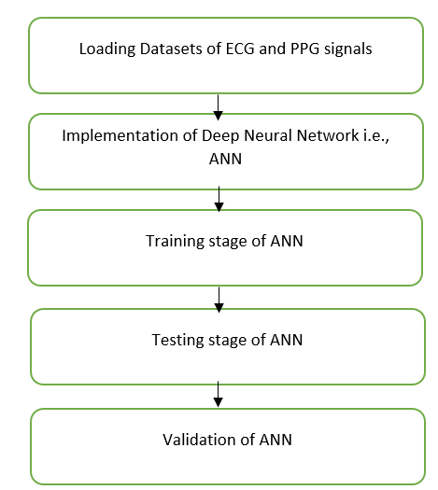
ARCHITECTURE

Slide 20
MODULES
1. Loading of datasets from databases of ECG and PPG signals.
2. Development of deep neural network based predictor known as ANN and its training and testing stages.
3. Validation for its accuracy.

Slide 21
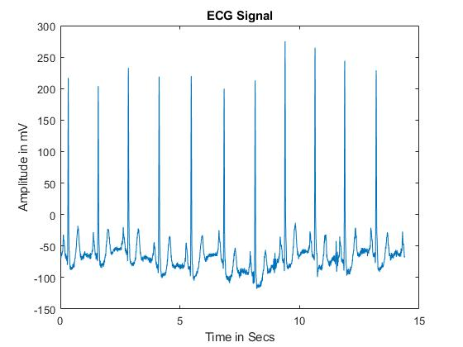
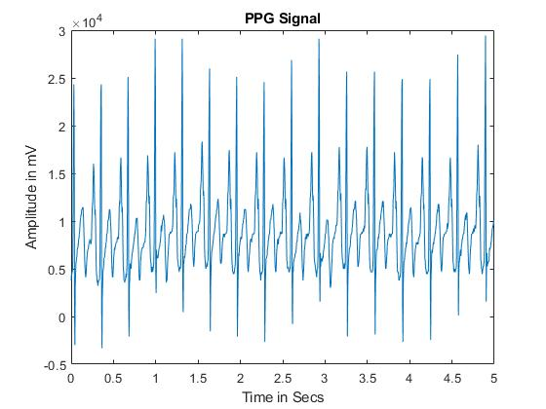
RESULTS

Slide 22
CONCLUSION
In conclusion, the AI-based decision support system for predicting Heart strokes on the basis of ECG and PPG signals. The implementation of deep neural network based decision making for predicting Heart strokes results in very closer predictions of about 95% of accuracy which is much higher than the previously existing works. The implementation of neural network is more robust because of its neural connections and networking strategy which maintains the estimates as close as possible until they meet the actual values through back propagation.

Slide 23
REFERENCES
[1] G. Sannino and G. De Pietro, ‘‘A deep learning approach for ECG-based heartbeat classification for arrhythmia detection,’’ Future Gener. Comput. Syst., vol. 86, pp. 446–455, Sep. 2018.
[2] J. S. Wang, W. C. Chiang, Y. L. Hsu, and Y. T. C. Yang, ‘‘ECG arrhythmia classification using a probabilistic neural network with a feature reduction method,’’ Neurocomputing, vol. 116, pp. 38–45, Sep. 2013.
[3] I.-S. Oh, J.-S. Lee, and B.-R. Moon, ‘‘Hybrid genetic algorithms for feature selection,’’ IEEE Trans. Pattern Anal. Mach. Intell., vol. 26, no. 11, pp. 1424–1437, Nov. 2004.
[4] S. De Raedt, A. De Vos, and J. De Keyser, ‘‘Autonomic dysfunction inacute ischemic stroke: An underexplored therapeutic area?’’ J. Neurol. Sci., vol. 348, nos. 1–2, pp. 24–34, Jan. 2015.
[5] C. P. Warlow, ‘‘Epidemiology of stroke,’’ Lancet, vol. 352, pp. 1–4, Oct. 1998.

Slide 24
[6] K.-D. Seo, M. J. Kang, G. S. Kim, J. H. Lee, S. H. Suh, and K.-Y. Lee, ‘‘National trends in clinical outcomes of endovascular therapy for ischemic stroke in South Korea between 2008 and 2016,’’ J. Stroke, vol. 22, no. 3, pp. 412–415, Sep. 2020.
[7] T. D. Musuka, S. B. Wilton, M. Traboulsi, and M. D. Hill, ‘‘Diagnosis and management of acute ischemic stroke: Speed is critical,’’ Can. Med. Assoc. J., vol. 187, no. 12, pp. 887–893, Sep. 2015.
[8] Q. Song, X. Liu, W. Zhou, L. Wang, X. Zheng, X. Wang, and S. Wu, ‘‘Long sleep duration and risk of ischemic stroke and hemorrhagic stroke: The Kailuan prospective study,’’ Sci. Rep., vol. 6, no. 1, pp. 1–9, Sep. 2016.
[9] J. Yu, S. Park, H. Lee, C. S. Pyo, and Y. S. Lee, ‘‘An elderly health monitoring system using machine learning and in-depth analysis techniques on the NIH stroke scale,’’ Mathematics, vol. 8, no. 7, pp. 1–16, Jul. 2020.
[10] World Health Organization. The Top 10 Causes of Death. Accessed: Apr. 22, 2022. [Online]. Available: https://www.who.int/newsroom/fact-sheets/detail/the-top 10-causes-of-death.

